Slide 1
Empowering SMEs
Debt Equity Valuation Advisory TEV Insolvency Training
The Role of Financial Expertise & Guidance
JYOTI PRAKASH GADIA
Managing Director Resurgent India Limited

Slide 2
Emerging Era of Technology “MSMEs”
Debt Equity Valuation Advisory TEV Insolvency Training
Innovation is the key
Get Attached to a bigger Company
Span of control is becoming bigger
Deﬁne the core – Specialist Business
More centralization
Company information in the public domain
Freelance employees
Prices will be driven down in the full value chain
Regulatory Privacy
The transformation from unorganized to organized..

Slide 3
“Digital Transformation”
Debt Equity Valuation Advisory TEV Insolvency Training

Slide 4
Physical World India- 2.3 Million
Debt Equity Valuation Advisory TEV Insolvency Training
Digital World
India- Ola and Uber- 1.45 Million

Slide 5
Debt Equity Valuation Advisory TEV Insolvency Training
Physical World
Digital World

Slide 6
Debt Equity Valuation Advisory TEV Insolvency Training
Digital World
20 Million Users Globally
Physical World
6 Trillion Sticks Globally

Slide 7
Digital World
$ 22 Billion Globally Industrial Robot Price $ 50K-80K
Debt Equity Valuation Advisory TEV Insolvency Training
Physical World
3.43 Billion workers Globally

Slide 8
Total Global Digital Payment Transactions
$9.47 trillion
Debt Equity Valuation Advisory TEV Insolvency Training
Total Value of Cash Transactions per Day Worldwide $7.6 trillion

Slide 9
Total Global Population 8 billion
Debt Equity Valuation Advisory TEV Insolvency Training
Total Internet User Globally 5.3 billion

Slide 10
THE PROFESSIONAL
Debt Equity Valuation Advisory TEV Insolvency Training
Growth Ladder
Initially, you are paid for what you do
Then, for what you know
And eventually, for whom you know

Slide 11
BUILDING BRIDGES
Debt Equity Valuation Advisory TEV Insolvency Training
to Success
Trust Hard Work Capability Relationship

Slide 12
RAMPING UP
Debt Equity Valuation Advisory TEV Insolvency Training
Most difﬁcult transition/non-doable transactions at the beginning
Don’t commit in partnerships – objectives change
Swift risk/reward – it’s difﬁcult to continue
Focus on cash ﬂow
Link everything to PBT/cash ﬂow (ﬁxed, low, variable, high) Whatever is possible

Slide 13
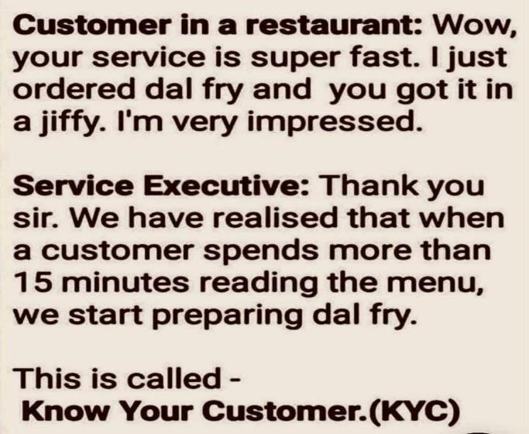
Debt Equity Valuation Advisory TEV Insolvency Training

Slide 14
BUSINESS DEVELOPMENT
Debt Equity Valuation Advisory TEV Insolvency Training
TRUST (Heart)
Openness/honesty
Genuine care – getting the client connected to places/persons who matter to them
Client problem solving approach Reference
Common linkage
CAPABILITY (Brain)
Product knowledge (market, product, institutions, etc.) Track record
Knowledge about industry Commitment – clients can see through it

Slide 15
BUSINESS DEVELOPMENT
Debt Equity Valuation Advisory TEV Insolvency Training
+ Trust – Capability
Does not follow up or client does not respond to e-mails;
the client does not share information
Delayed response. Trying to avoid.
- Trust + Capability
Work/mandate is not converted.
When they meet, he will be very courteous.
But you won’t see action thereafter.
Partial mandate
No risk mandate to client
+ Trust + Capability = Relationship
Since trust building takes time, in IB people accept
mandates of this kind.

Slide 16
POINTS FOR BUSINESS DEVELOPMENT
Debt Equity Valuation Advisory TEV Insolvency Training
Sharing success stories/experience
Passion for work
Never take the extreme position – especially politically/religiously You don’t need to agree all the time
Humility pays, always
Be persistent – sometimes it takes a year to close the deal even after numerous meetings with the client
How to get 7-8 meetings before a prospect is converted to a client is a challenge.
Go prepared, always

Slide 17
POINTS FOR BUSINESS DEVELOPMENT
Debt Equity Valuation Advisory TEV Insolvency Training
Not everyone can be your client – if you can't add value
don’t take the mandate
Set clear expectations, to the extent possible
Word of mouth – past executed mandates are a good
reference point
Try to solve the client’s immediate problems

Slide 18
MASTERING THE GAME
Debt Equity Valuation Advisory TEV Insolvency Training
UPCOMING BUSINESS OPPORTUNITIES
IBC –Debtors realisation, Arbitration purchase, Incentive from central and state govt.
Advising companies to purchase stressed assets – (credential, assets, loss making companies, scrap, listed entites).
On one side of the deal - we should know the best.
In investment banking - Scout for deals that speciﬁc credit funds/ NBFCs are looking for.
SME exchange
MSME REIT

Slide 19
Your Belief System
Debt Equity Valuation Advisory TEV Insolvency Training
Smartest
Strongest
Fastest
Biggest
But the king of the jungle is …

Slide 20
THANK YOU
Debt Equity Valuation Advisory TEV Insolvency Training

